Slide 1
2nd Global Workshop on Integrated Monitoring of SDG 6 on Water and Sanitation
Select Arabic
or Russian in Zoom
KICK-OFF SESSION
9 December 2021, 08.00-10.00 CET, online

Slide 2
A few exciting numbers
8.2
130
193
1702
2146

Slide 3
Expected outcomes
Exchange of good practices on key topics
Reflections and feedback on past work on SDG 6
Identification of needs and priorities for future SDG 6 monitoring
Dialogue between focal points within each country

Slide 4
Global workshop at a glance
→ Kickoff session (today)
Background on IMI-SDG6
Voluntary country assignment
External training on data communication
→ Session 1. Stock-taking SDG 6 monitoring to date (8 Feb 2022)
Collecting country feedback on the work and support on SDG 6 monitoring
Discussing cross-cutting challenges and how to improve country level collaboration
→ Session 2. Data for policy and communication (9 Feb 2022)
Using the collected data to inform policy, including how to communicate the data in a way that make it actionable for various audiences
Case studies on data use at various levels (from global to local)
Examples and feedback from an external communications expert
→ Session 3. Needs and priorities for the future (10 Feb 2022)
‘Real time consulting’
Needs and priorities for the future work on SDG 6 monitoring

Slide 5
Practicalities
How to activate interpretation (Arabic and Russian):
Select your preferred language channel (also for English speakers)
How to interact during the session:
Turn on your video camera (if your connection allows for it), and check your name
Present yourself, comment and ask questions in the Chat
Raise your hand to take the floor during Q&A, and turn on video and microphone when given the floor
Participate in Polls
→ remember to mute your microphone when not speaking

Slide 6
Which region are you from?

Slide 7
Which is your favourite SDG 6 target?

Slide 8
1. Overview of UN-Water IMI-SDG6 and cross-cutting resources

Slide 9
2030 Agenda for Sustainable Development Sustainable Development Goal 6
“Ensure availability and sustainable management of water and sanitation for all”

Slide 10
2030 Agenda for Sustainable Development Follow-up and review (paragraph 72-76)
We commit to engaging in systematic follow-up and review of the implementation of this Agenda over the next 15 years ... [It] will make a vital contribution to implementation and will help countries to maximize and track progress in implementing this Agenda in order to ensure that no one is left behind …
Operating at the national, regional and global levels, it will promote accountability to our citizens, support effective international cooperation in achieving this Agenda and foster exchanges of best practices and mutual learning. It will mobilize support to overcome shared challenges and identify new and emerging issues ...
[The processes] will be rigorous and based on evidence, informed by country-led evaluations and data which is high-quality, accessible, timely, reliable and disaggregated by income, sex, age, race, ethnicity, migration status, disability and geographic location and other characteristics relevant in national contexts …
… the global review will be primarily based on national official data sources …
[The processes] will require enhanced capacity-building support for developing countries, including the strengthening of national data systems and evaluation programmes … [and] benefit from the active support of the United Nations …
Purpose of global indicators
Roles and responsibilites
SDG 6 monitoring

Slide 11
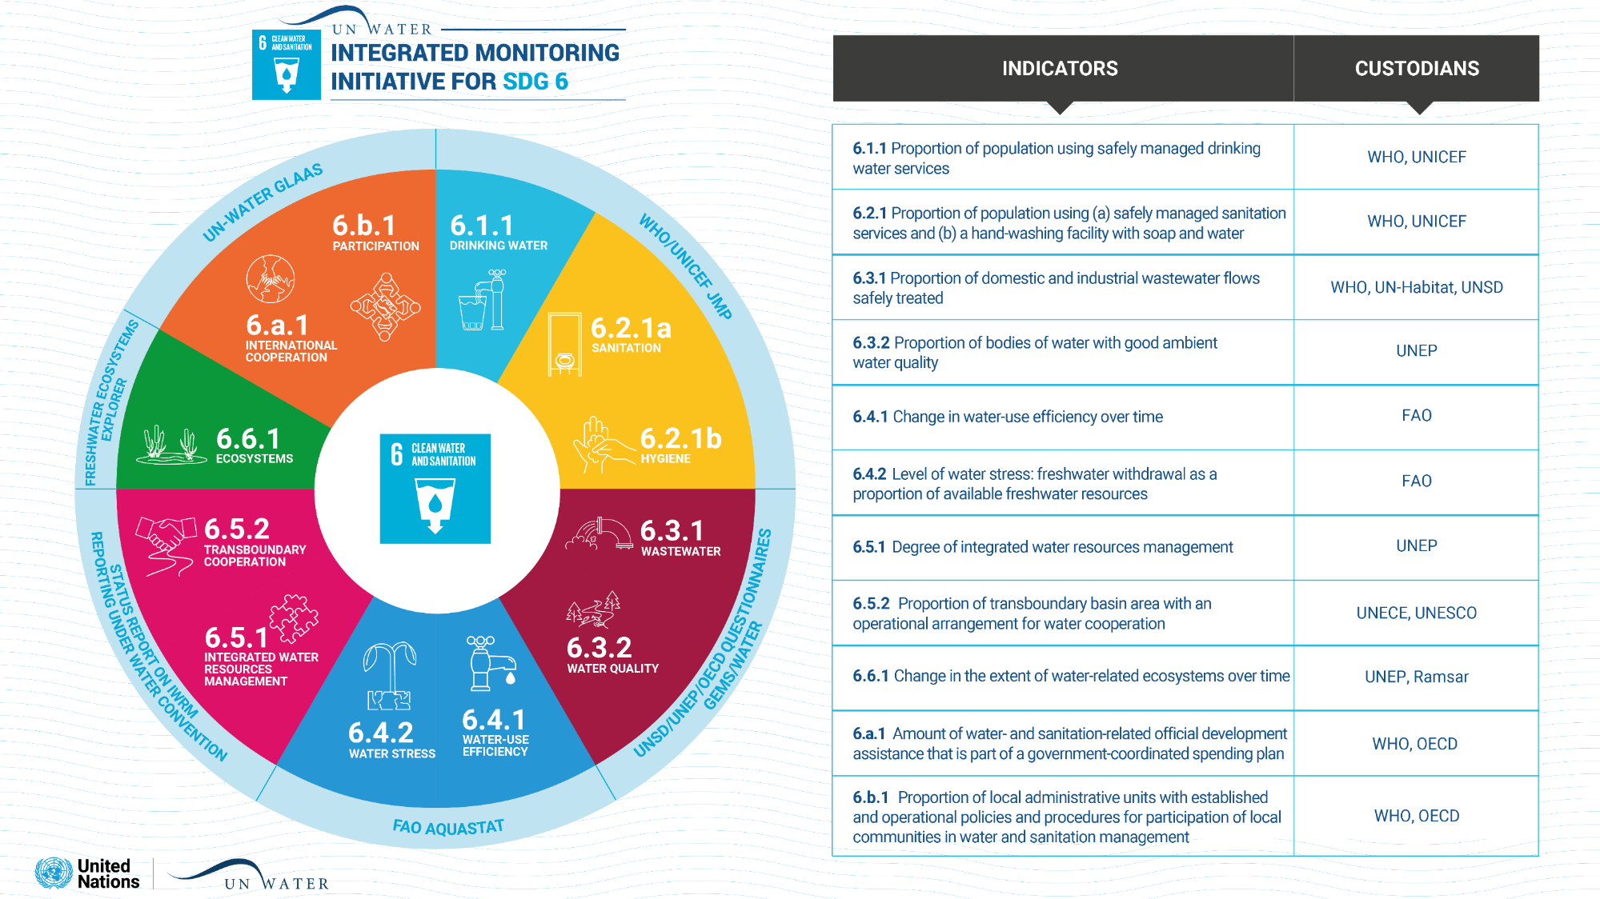
The work is possible thanks to the generous support of the Governments of Austria, France, Germany, the Netherlands, Sweden and Switzerland.

Slide 12
IMI-SDG6 goal and objectives
Goal: Acceleration of the achievement of SDG 6 on water and sanitation through evidence based policies, regulations, planning and investments
1. Countries collect, analyse and report SDG 6 data
Maintain monitoring framework for SDG 6 global indicators
Technical support to countries to collect, analyse, report and use water and sanitation data
Compile country data and report on global progress towards SDG 6
2. Policy- and decision-makers at all levels use SDG 6 data
Institutional support to countries on cross-cutting issues and integration
Inform policy- and decision-makers on SDG 6 status and interlinkages
Coordinate global monitoring and reporting

Slide 13
IMI-SDG6 phases 2015-2030
Within each phase:
Capacity building
Global data compilation
Progress reporting
Outreach + planning
1. Global baseline
2015-2018
2. Build national ownership
2019-2022
3. Integrate and mainstream
2023-2026
4. Consolidate and sustain
2027-2030
Phases:
Ongoing phase 2 external review...

Slide 14
2020 Data Drive and associated support
UN sends data request to countries / estimates based on open data
Country compiles / validate data and submit to UN
Country signoff and publication of data
UN validates data together with country
Guidance on data collection and reporting (e.g. methodologies)
Online support (e.g. helpdesk, national/regional/global webinars, e-learning, good practices, case studies)
Face-to-face support (e.g. country visits, regional/global workshops)
Support in calculating indicator value
Data and progress reporting
Support to countries
https://www.sdg6monitoring.org/

Slide 15
Institutional and cross-cutting support
Joint outreach campaign with information about timelines and support across indicators
Focal point database for all indicators including NSO, password-protected country views shared with all overall focal points (130+ countries)
Support to agencies to help identify technical focal points and to facilitate the submission of data from countries
Additional support offered to overall focal points in 30 countries, including bilateral calls and webinars with all focal points in the country
LinkedIn community of practice
SDG 6 Data Portal

Slide 16
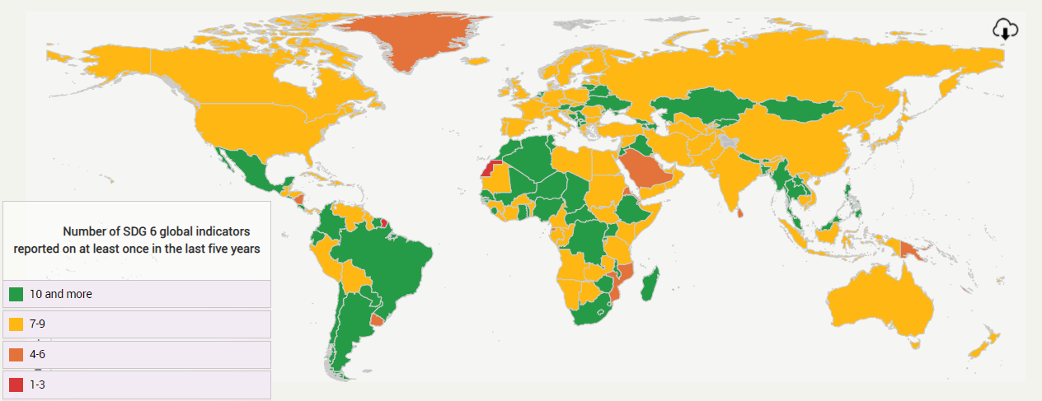
Results: Number of SDG 6 indicators reported on by each country (or area)
Source: https://sdg6data.org/ November 2021
Average number of SDG 6 global indicators reported on by UN Member States: 0 in 2015, 7.0 in 2019, 8.2 in 2021

Slide 17
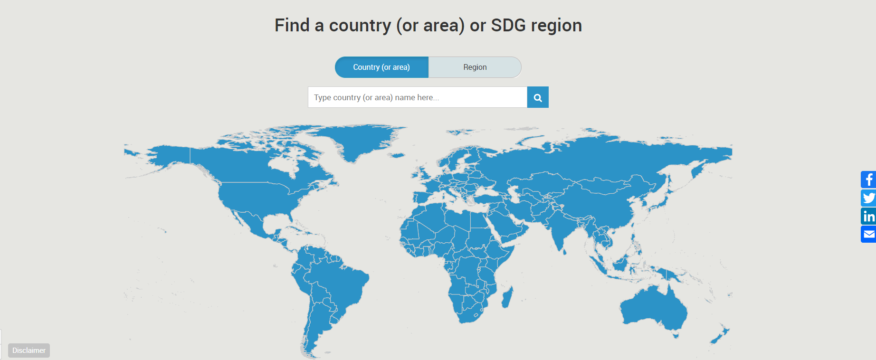
Country snapshots in SDG 6 Data Portal
https://sdg6data.org/

Slide 18
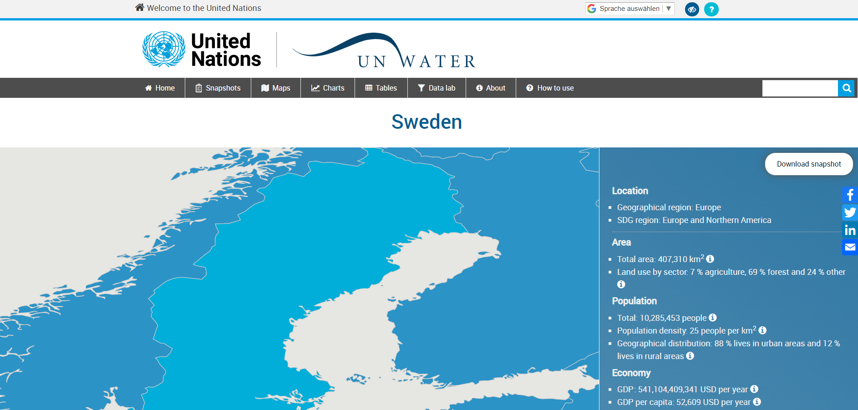
Country snapshots in SDG 6 Data Portal
https://sdg6data.org/

Slide 19
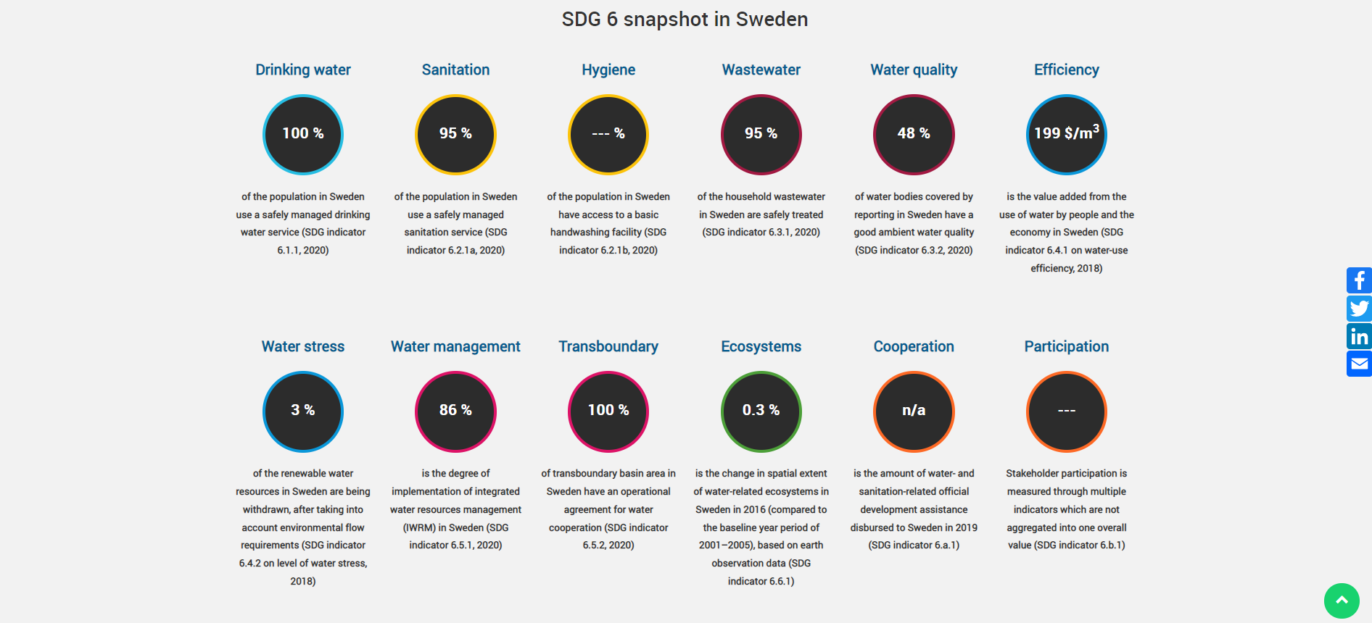
Country snapshots in SDG 6 Data Portal
https://sdg6data.org/

Slide 20
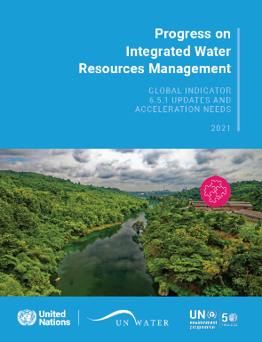
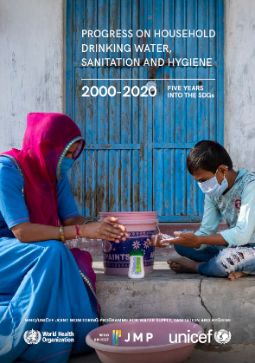
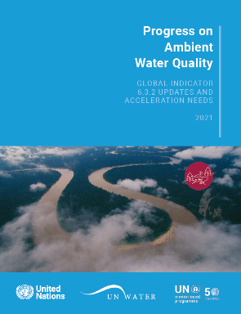
Results: Progress reporting
Access reports and infographics →
https://www.unwater.org/publication_categories/sdg6-progress-reports/

Slide 21
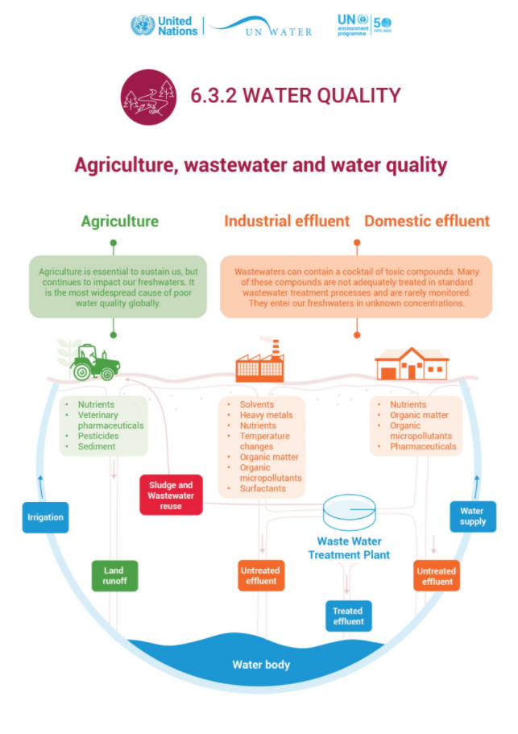
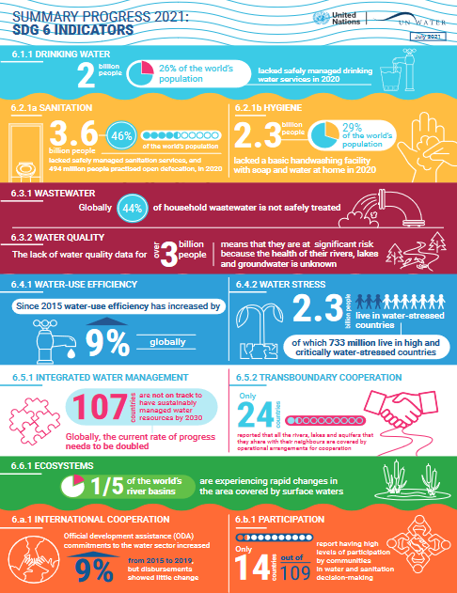
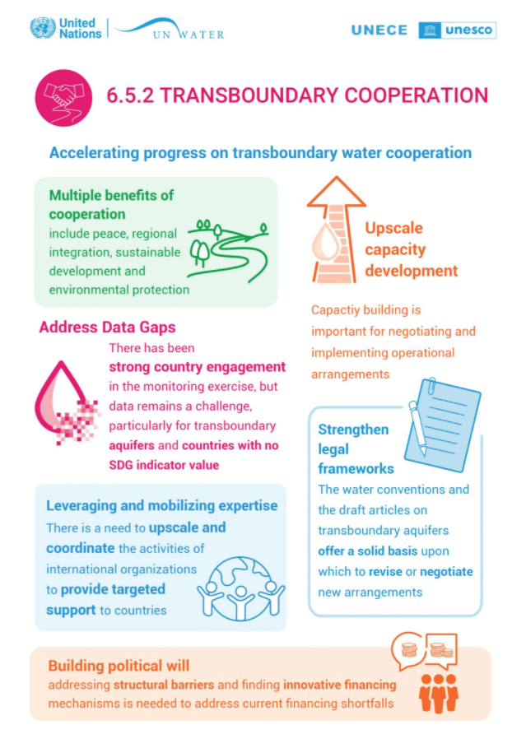
Results: Progress reporting
Access reports and infographics →
https://www.unwater.org/publication_categories/sdg6-progress-reports/

Slide 22
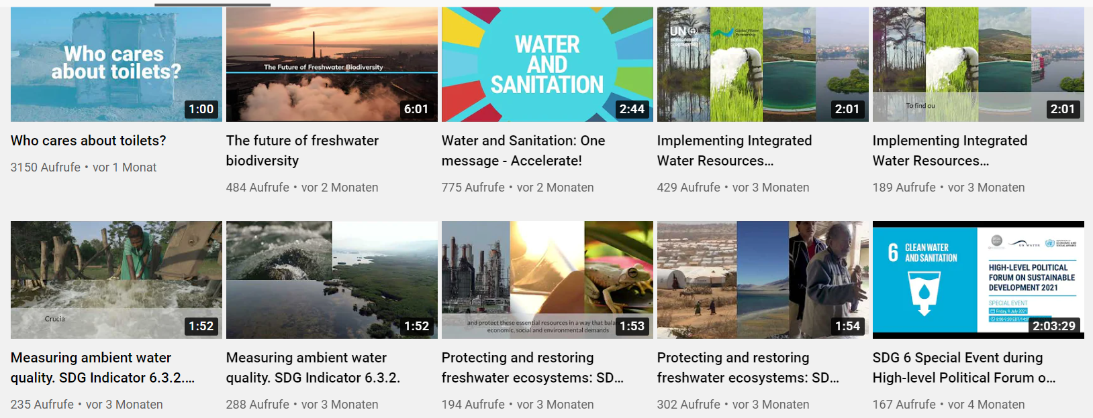
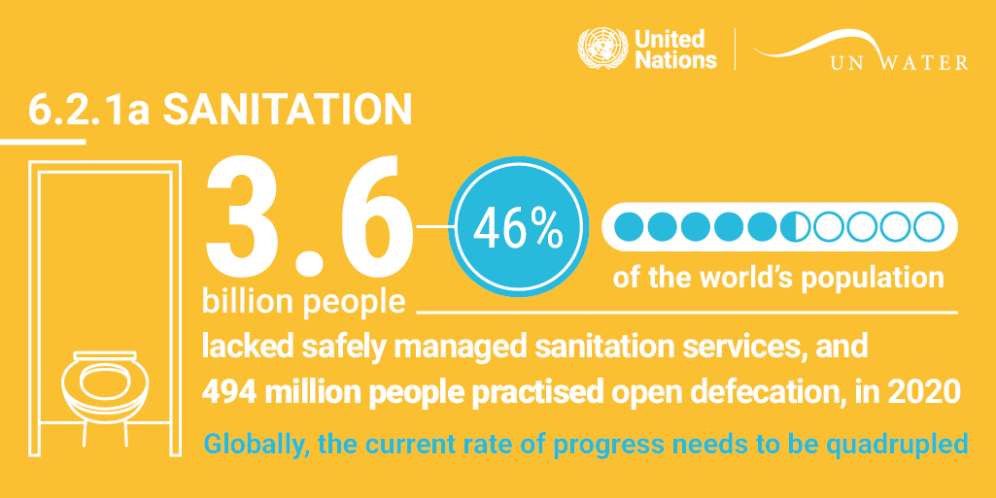
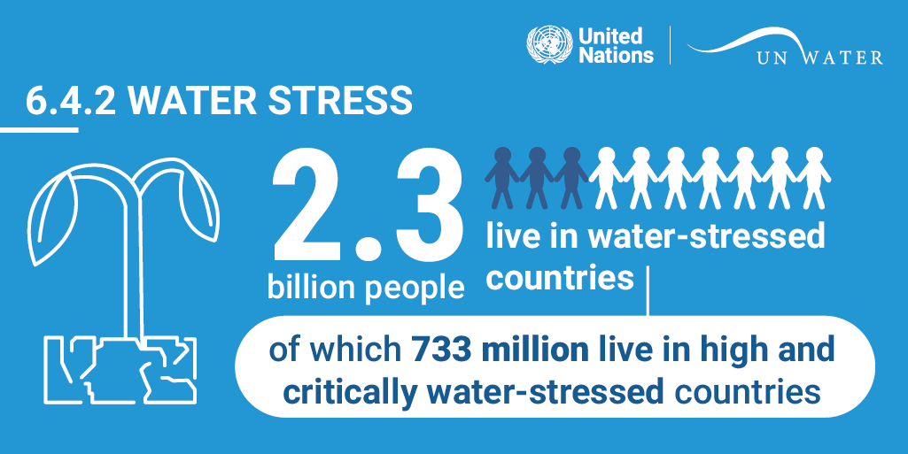
Results: Progress reporting
In case you missed the indicator webinars →
https://www.unwater.org/sdg-6-progress-webinars/

Slide 23
Global need for evidence
Every year: Data input to High-level Political Forum (HLPF) through UNSD
Every year: Annual moment UN-Water Global Acceleration Framework
18 March 2021: High-level meeting of the President of the General Assembly
2022: Preparatory process Midterm Comprehensive Review of International Decade for Action (2018-2028), regional and global meetings
22 March 2023: United Nations Conference on the Midterm Comprehensive Review of International Decade for Action, New York
July 2023: Next HLPF in-depth review of SDG 6

Slide 24
Q&A

Slide 25
2. Introduction to the country monitoring team voluntary assignment

Slide 26
What is the role of the different country focal points?
Indicator-specific technical focal points are periodically receiving requests for data from the custodian agencies, and are also the primary contacts for capacity building and other outreach activities. Often, the focal points are working with colleagues within and outside their organization.
National statistical office (NSO) has overall responsibility for SDG reporting.
Overall focal point who can work with indicator-specific focal points and promote coordination and collaboration across the indicators. The main point of contact for communications with IMI-SDG6 for all broad issues related to SDG 6 monitoring and the integrated analysis and use of data.

Slide 27
Engagement with countries
Country (intersectoral) monitoring team
For planning and coordinating monitoring and reporting and analysing data across targets and indicators
UN-Water Integrated Monitoring Initiative for SDG 6
Overall focal point
National statistical office
Custodian agencies for SDG 6 global indicators
Technical team for monitoring and reporting on SDG indicator X
Technical team for monitoring and reporting on SDG indicator Y
Technical team for monitoring and reporting on SDG indicator Z
Technical focal point for SDG indicator X
Technical focal point for SDG indicator Y
Technical focal point for SDG indicator Z
Representatives from all relevant sectors and stakeholders involved in the monitoring of SDG indicator X
Representatives from all relevant sectors and stakeholders involved in the monitoring of SDG indicator Y
Representatives from all relevant sectors and stakeholders involved in the monitoring of SDG indicator Z
Long-term objective
Contribute to an integrated monitoring process in countries, where cross-sectoral coordination and collaboration improves the availability, accessibility and integrated analysis of high-quality data for policy- and decision-making

Slide 28
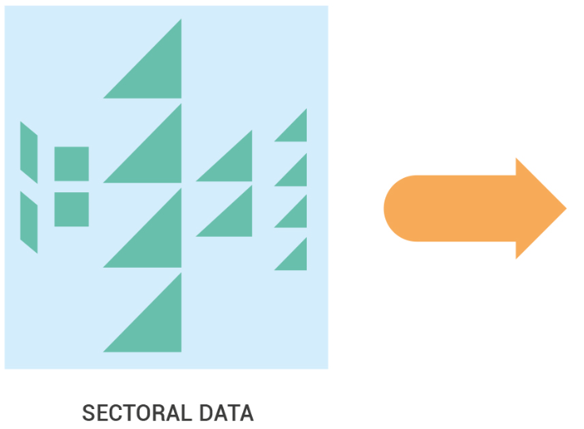
National need for evidence
Notes:
Over to Will...

Slide 29
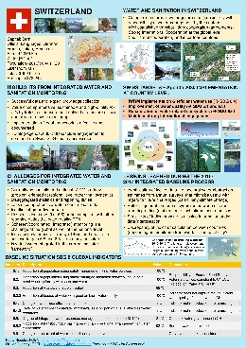
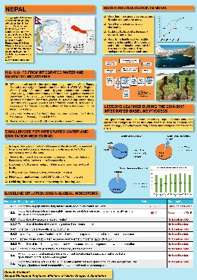
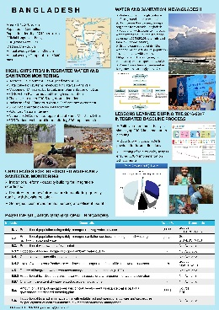
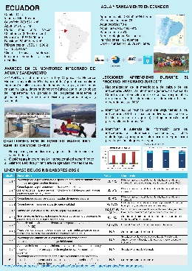
Voluntary country assignment

Slide 30
Voluntary assignment: Proposed process
Get in touch with other SDG 6 focal points in your country to schedule a meeting (virtual or face-to-face if the situation allows for it).
Each focal point prepares for the meeting by looking at the questions from her/his perspective, and consults with other colleagues as necessary.
During the meeting, all focal points participate and questions are discussed in as a group, to capture both indicator-specific and cross-cutting experiences.
One focal point acts as rapporteur (potentially the overall focal point) and summarizes the discussion and completes the assignment based on the provided template (this PPT document).
The completed assignment is reviewed by all focal points and then submitted to monitoring@unwater.org by 31 January 2022.
All focal points participate in the workshop to share the country‘s experience with other participating countries.

Slide 31
SDG 6 focal points in the country
Instructions
Please list all the focal points who have participated in the assignment exercise (name, organization, and indicator focus).

Slide 32
Experience to date on SDG 6 monitoring and reporting
Instructions
Please reflect on the work on SDG 6 monitoring within your country during the last few years (2018-2021). Please summarize the discussion here (you can add more slides if necessary).
Possible questions to consider:
How did you organize the data collection and which institutions/organisations were involved (e.g. national statistical office, line ministries, local governments, regional organisations, academia, private sector, NGOs etc.)?
Did you discuss the work with other (SDG 6) focal points in your country?
Were you able to report the requested data (if not, why)? What are the main data gaps?
What did you think about the reporting process?
What has been the value of the process at the national level?
What support did you receive from the UN custodian agency (e.g. methodology, helpdesk, bilateral calls, webinars)?
What were the main challenges and opportunities encountered? Which are the main lessons learned?
How could you improve the institutional collaboration across indicators and sectors?

Slide 33
Use of data to inform policy
Instructions
High-quality data enable evidence-based policy- and decision-making, ensure accountability and transparency, and attract political commitments and public and private investments. Please reflect on how the collected data/resulting analysis are used for policy-making and other purposes at various levels within your country. Please summarize the discussion here (you can add more slides if necessary).
Possible questions to consider:
Which are the main uses of the data (e.g. raise awareness, advocate action and funding) at what local, national and international levels (e.g. development partners, financial institutions)?
Which policy processes are benefitting the most from the data?
What types of analyses are you doing with the data, and are you combining the data with data from other sectors?
Who are you sharing the data with (which institutions/sectors, at what level of seniority)? Was the reporting process helpful in terms of subsequent data sharing and use?
How do you share the results (e.g. technical reports, summary reports, website, social media, newspapers, meetings etc.)?
Which are the main challenges and opportunities for using data to inform policy decisions?
How could you improve the uptake of data across audiences/sectors?

Slide 34
Needs and priorities for the future
Instructions
Based on your discussions on past monitoring experience and data use, what are the main needs and priorities for future water and sanitation monitoring in your country? Please summarize the discussion here (you can add more slides if necessary).
Possible questions to consider
What are you currently doing to address existing data gaps?
Which are the main areas that you would like to see improve for future monitoring, reporting and utilization of SDG 6 data in your country? You may wish to consider different accelerators such as governance, capacity development, finance and innovation.
Which needs are indicator-specific and which are cross-cutting?
At what level and within which sectors could/should the different needs be addressed?
What could be done by whom in the short/medium/long term to meet these needs?
How do you prioritize the different needs?

Slide 35
Examples and ideas for communicating data (optional)
Instructions
To ensure that stakeholders are able to use the data/analysis, these need to be presented to them in an understandable and actionable way. Technical experts may ask for a lot of detail to interpret the findings, whereas high-level policy makers are interested in the overall trends, impacts and next steps. And the general public may want to know about the current situation and what can be done to improve it, in simple and clear words and illustrations. As we will learn from our communication expert during the December kick-off session, the selection and presentation of data need to be tailored to the audience.
Please share with us examples of how you are communicating your data/analysis with different types of audiences (e.g. with screen shots or links). If you want, you can also share your ideas on this, e.g. sketches and prototypes. A selection of these examples/ideas will be presented by the communications expert during the global workshop.

Slide 36
Q&A

Slide 37
3. How to communicate data effectively Dr. Vanessa Vargas-Nguyen University of Maryland Center for Environmental Science

Slide 38
See you in February
www.sdg6monitoring.org
www.sdg6data.org

